Slide 1
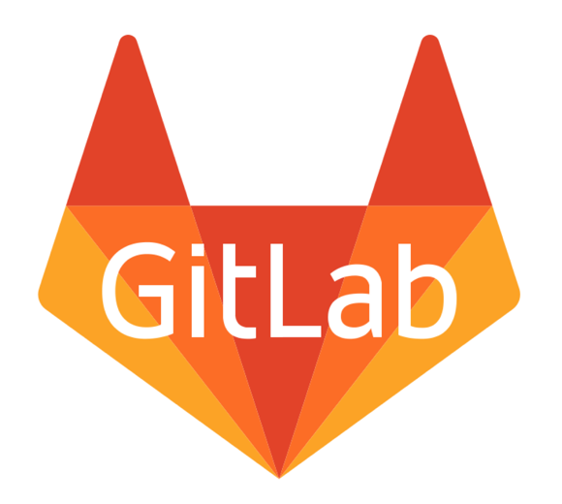
GitLab [Configuration Management Tool]
Group - 8

Slide 2
Members
Myat Pwint Phyu ( 4BIS – 44)
Thet Su Naing ( 4BIS – 34)
Thazin Hlaing ( 4BIS – 23)
Su Sandi Htun ( 4BIS – 42)

Slide 3

What is version control system?
Version control is a system that records changes to a file or set of files over time so that you can recall specific versions later.
Git is a free and open source distributed version control system designed to handle everything from small to very large projects with speed efficiency.

Slide 4
What is GitLab ?
Web-based Git repository manager with a wiki, issue tracking features, using an open source license, developed by GitLab Inc.
The code is written in Ruby, later, some parts have been written in Go.
Today we are releasing version 9.4.3 for GitLab Community Edition(CE) and Enterprise Edition(EE). This version resolves a number of regressions and bugs in the 9.4.2 release and prior versions.

Slide 5
Products
Below are self hosted products which are available on GitLab.com
Community Edition (CE)
Ideal for personal projects or small teams with minimal user management and workflow needs
Free (unlimited users)
Enterprise Edition Starter (EES)
Ideal for co-located teams who need additional security and workflow controls for their professional projects.
$ 3.25 per user per month ( paid annually at $39)
Enterprise Edition Premium (EEP)
Ideal for distributed teams who need advanced workflow controls, advanced CI/CD, advanced monitoring, advanced project management and high availability.
$ 16.59 per user per month (paid annually at $199)

Slide 6
Features
Scalability
GitLab has been battle-tested to scale to over 1,000,000 users on GitLab.com.
Availability
Support for high availability deployments and disaster recovery, means your development environment and knowledge is safe in our hands.
Compliance
Comply with licensing, legal and other requirements using tools built into GitLab.

Slide 7
Features – cont’d
Security
Secure your most precious data and assets on GitLab confidently.
Services
It provides various services to help get your GitLab instance running and help it run smoothly.
Wiki
Easily create documentation and related content for your projects in GitLab’s powerful, Git-powered wikis.

Slide 8
Features – cont’d
Pages
GitLab Pages hosts static websites, built right in GitLab CI.
Service Desk
Service desk helps companies receive and manage external tickets in their issue tracker.
Innersourcing
The power and advantages of open source within your organization without giving away your source code.
Integration
Integrate with GitLab using a comprehensive API and built-in integrations with other services.

Slide 9
Features – cont’d
Import
Import your code, tickets, issues and other data from other solution into GitLab.
Open core
GitLab is open-core which provides users with access to the source code and the ability to mofiy it as they wish.
Efficiency
GitLab helps you get more done, faster with a deeply integrated feature set.

Slide 10
The GitLab Advantage
A convenient user interface enables users to access everything from one screen : projects, latest projects, users, latest users, groups and stats
Setting allow users to control whether a repository is public or private.
Snippet support lets users share small pieces of code from a project, without sharing the whole project.
Protected branches are a new way to keep code safe. They allow users to set higher permissions on a project, so only certain people are able to push, force push or delete code in a branch.
You can attach files like comments to any communications in GitLab.

Slide 11
The GitLab Disadvantage
Interface can be slow : Changing between pages can take a while to load, as it is a pretty heavy Rails application.
Gitlab.com git hosting not always stable : Old issues such as repository corrupiton can occur in your repositories and not a lot of support is given for free users.
Hosting requires minimum of 2 GB RAM
Complex UI

Slide 12
GitLab Vs GitHub
Key Differences between GitLab and GitHub
Authentication Levels
With GitLab, you can set and modify people’s permissions according to their role. In GitHub, you can decide if someone gets a read or write access to a repository. With GitLab you can provide access to the issue tracker (for example) without giving permission to the source code.
Attachments
In GitLab you can attach any file to any issue. You simply can’t do that inside GitHub.

Slide 13
GitLab Vs GitHub
Issue Tracking
If you are using GitHub issues you might think that it lacks some functionality. GitLab provides a powerful Issue Tracker that lets you change status and assign for multiple issues at the same time.
Work in progress status
With GitLab, developers can label a project with “Work in progress” which gives collaborators a clear sign that the code is not finished. This feature prevents code being merged with other code before it is actually finished.

Slide 14
Commands
To create a repository
“ $ git init “
To add file to the staging area for Git
“ $ git touch example.html “
To return the current state of the repository
“ $ git status “
To record the changes made to the file to a local repository ( commit)
“ $ git commit –m “ Add sum” “

Slide 15
Commands
Git push
“ $ git remote add origin <remote_URL/remote_name> “
“ $ git push origin master “
Git pull
“ $ git pull origin master “
Clone
“ $ git clone <remote_URL> “

Slide 16
Thank You

